Slide 1

Revenue Model
A revenue model is a framework for generating financial income. It identifies which revenue source to pursue, what value to offer, how to price the value, and who pays for the value. It is a key component of a company's business model.

Slide 2
how your company is going to earn money or revenue.
For existing companies ---its simple
For startups ---its about highlighting potential sources of generating sales or income.
industry practices or may be a new income source

Slide 3
Here are few revenue models :
Ad-Based Revenue Model
Subscription Revenue Model. ...
Web Sales
Direct Sales
Channel Sales (or Indirect Sales)
Retail Sales

Slide 4
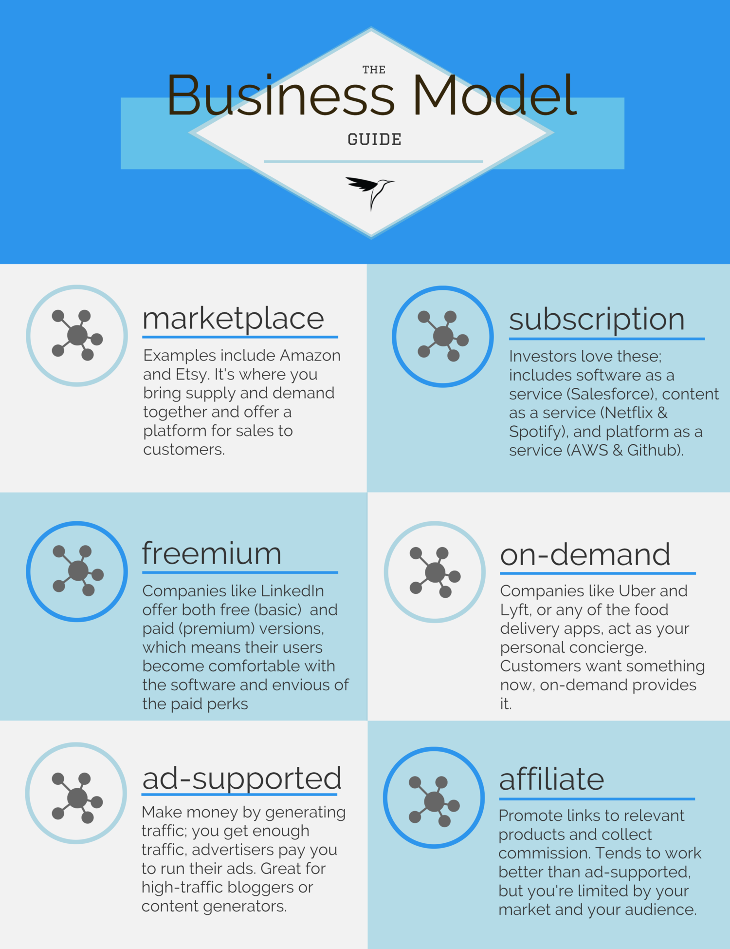

Slide 5
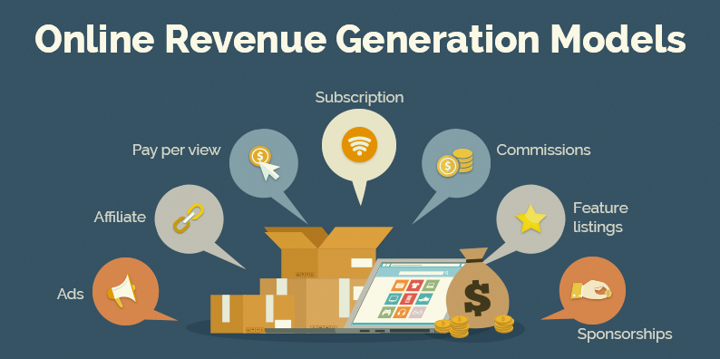
Example

Slide 6
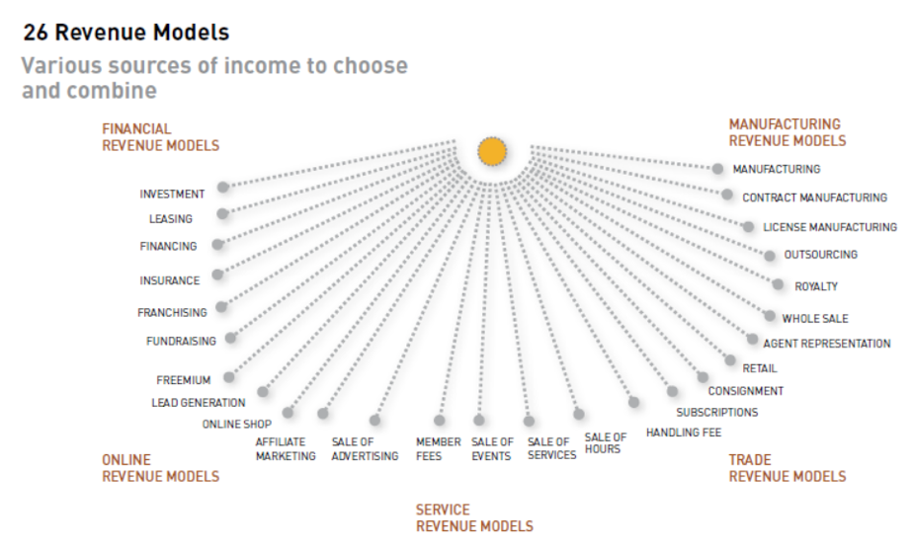
Example no. 2

Slide 7
Reading / blog:
The Top 12 Revenue Models You Should Consider for 2020.
WRITTEN BY Roamy.
Personal blog: www.behaveyourbusiness.com (behavior science for business
https://medium.com/@roamy/the-top-12-revenue-models-you-should-consider-for-2020-2229e98d3477
Provided in word document as well.

